Slide 1
EP Channel Analysis
Which channel should we focus on in 2019?

Slide 2
Assumptions
Each order is identical:
In other words, each order placed by a user has the same monetary value to EP, i.e. brings in the same revenue at the same cost
Orders data is exhaustive and up to date with Users data
Customers with missing values can be removed from consideration for this analysis, especially when comparing both channels
For the statistical tests, we are assuming an approximately normal distribution for variables such as conversion days and total orders placed by a user

Slide 3
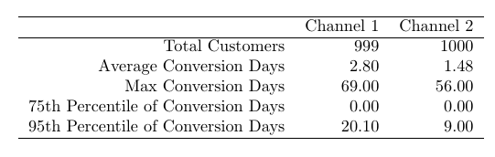
Understanding Our Users – Conversion Days
Both channels have a similar number of customers
At least 75% of both channels’ customers are converted on the same day (time between entering an email address and purchasing a product)
Channel 2 customers are typically converted twice as fast as Channel 1 customers

Slide 4
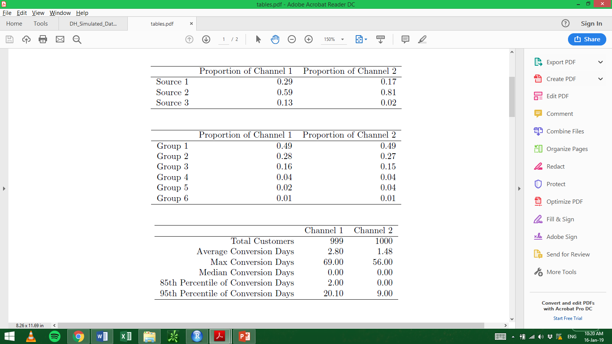
Understanding Our Users – Source
Channel 2 receives 81% of users from Source 2, and only 2% from Source 3
Chanel 1 receives 59% of users from Source 2, and a more modest 13% from Source 3
It looks like Source 2 gives away some of its lead/importance to other Sources when moving from Channel 2 to Channel 1

Slide 5
Understanding Our Users – Group
The demographic distribution split for both Channels is very similar
Both Channels receive ~50% of their users from Group 1, i.e. a majority of consumers live in very urban regions
Users from Groups 1-3 make up around 90% of the user base for both channels

Slide 6
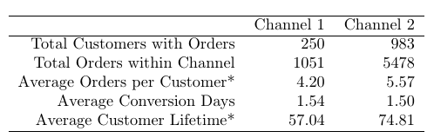
Channel 1 versus Channel 2 - practical
Out of the 999 Channel 1 users, only 250 have placed any orders
Extremely poor adoption compared to Channel 2, warrants further investigation.
Note the typical conversion days for Channel 1 improves from 2.8 to 1.54 when only considering Channel 1 users with order data, signifying those users who don’t order in Channel 1 take a long time to convert
On first glance, all three averages – orders, conversion days, and customer lifetime (time between the user’s first and last delivery) – are better under Channel 2

Slide 7
Channel 1 versus Channel 2 - statistical
A two-sample t-test was used to investigate if Channel 2’s average metrics were statistically significant from Channel 1’s average metrics
An asterisk (*) on the previous table indicates the test showed statistical significance at the 5% level for average orders and average conversion days
This means that we are “95% confident” that the difference in these averages between Channel 1 and Channel 2 are nonzero
In other words, Channel 1’s higher averages are likely not just due to chance

Slide 8
Caveats / Thinking Ahead
Caveats:
Only 25% of users in Channel 1 placed an order, this could be a data error
This analysis relies heavily on the assumption that each order is born equal, and has the same revenue and costs for EP
Future Improvements:
Incorporate revenue data by each order ID, a list of products ordered for each order ID (product IDs), and product costs by product ID
Unearth more data about what stage in the process Channel 1 users are abandoning the ordering process – do they browse but not find a product to their liking? Are their payment methods getting rejected?
Investigate the appropriate distribution for variables like conversion days, which is skewed heavily to zero

Slide 9
Conclusion
Discover why so many Channel 1 users do not place an order – either a data issue or a customer/product issue
Increasing adoption to mirror Channel 2 could yield huge gains
Further monetize Channel 2, which proves to be more valuable than Channel 1 by most measures – average orders and average lifetime (by user)

